Slide 1
BIE ELA & Math Spring 2024 Assessment Pre-Administration Training
January 17th – 19th &
January 24th – 26th, 2024
1

Slide 2
Welcome and Purpose
2

Slide 3
Welcome and Purpose
Welcome from the Chief Academic Office and the ELA/Math Assessment Team!
Aurelia Shorty, Dr. Carmelia Becenti, & Dr. BJ Howerton
The purpose of these trainings is to:
Provide implementation assistance to schools for BIE’s Summative ELA and Math Assessments for SY 2023-2024.
Provide a set of expectations for assessment tasks and activities before, during, and after testing.
To assist school staff with scheduling, the trainings will be recorded for your viewing convenience.

Slide 4
Housekeeping
Training PowerPoint will be posted to: https://bie.mypearsonsupport.com/
The trainings will be recorded.
Please be sure to mute your microphone, if applicable.
Questions may be posted in the Q&A.

Slide 5
BIE Guidelines
Paper-Based Tests (PBT) versus Computer-Based Tests (CBT):
The BIE will not order PBT for schools that have been identified to use the CBT. The BIE encourages schools use CBT if they have the technical capability to do so.
Exception would be for students needing paper as an accommodation for IEP or 504. Contact the BIE if you have further questions.
Participation – All students in grades 3-8 and 11 will take the Spring ELA and Math Assessment per ESSA.
No Remote Testing – If students are learning remotely and a school is not able to test students securely, contact BIE for guidance. Paper-based tests cannot be sent home.

Slide 6
Key Administration Dates
6

Slide 7
Key Administration Dates – Pre-Admin
JANUARY 29 - FEBRUARY 9
FEBRUARY 9
MARCH 4
Deadline for Initial Orders
Materials scheduled to arrive in schools
Student accommodations updated & verified in ADAM

Slide 8
Key Administration Dates – Admin
MARCH 5 - APRIL 25
MARCH 18 -APRIL 26
Additional Orders Window
TEST ADMINISTRATION WINDOW

Slide 9
Key Administration Dates – Post Admin
APRIL 26
MAY 3
MAY 9
MAY 17
Deadline to return scorable testing materials to Pearson
Deadline to return non-scorable materials to Pearson
Deadline to resolve Paper test alerts in ADAM
All tests Submitted in ADAM

Slide 10
NASIS
10

Slide 11
NASIS
NASIS Administrator
Demographic Information
Name
Gender
Date of Birth
Ethnicity
Grade
NASIS ID*
English Learner Participation
SPED Staff
SPED Bureau of Indian Education Reporting
Special Ed Status
Primary Disability
Special Ed Setting
IEP Review
Test Accommodations
Alternate Assessment

Slide 12
Test Structure and Guidelines
12

Slide 13
Test Structure and Guidelines
Computer-Based and Paper-Based Testing
March 18 – April 26, 2024
Test Administration
Window
English Language Arts
Grades 3-8
Grade 11
Mathematics
Grades 3-8
Algebra I
Algebra II
Geometry
Integrated Math
I, II, & III
Tests
Administered

Slide 14
Test Structure and Guidelines
On-Grade Level Testing Only
3-8 Math/ELA students are only allowed to take the test for their grade level (i.e., 3rd grader can take Grade 3 Math and Grade 3 ELA).
Grade 11 students can take Algebra I, Geometry, Algebra II or Integrated Math I, II, III. They should take the test that aligns with the course they are currently enrolled in.
If a student is enrolled and takes more than 1 HS Math test, the more advanced test will be reported (i.e., if a HS student takes Algebra I & Algebra II, only Algebra II will be reported).
Exception: Grade 8 students can take Algebra I if they are currently enrolled in Algebra I.

Slide 15
Test Structure and Guidelines – ELA Testing Times
Grade(s)​ | Content Area/Course​ | Number of Units​ | Time​ | Total Time​
3​ | ELA/Literacy​ | 3​ | Units 1-2: 75 minutes Unit 3: 35 minutes​ | 185 minutes​
4-8​ | ELA/Literacy​ | 3​ | Units 1-2: 90 minutes Unit 3: 40 minutes​​ | 220 minutes​
11 | ELA/Literacy​ | 3​ | Units 1-2: 90 minutes Unit 3: 40 minutes​​​ | 220 minutes​

Slide 16
Test Structure and Guidelines – Math Testing Times
Grade(s)​ | Content Area/ Course​ | Number of Units​ | Calculator | Time​ | Total Time​
3​-5 | Mathematics | 3​ | No Calculator | 60 minutes​ | 180 minutes​
6 | Mathematics | 3 | Unit 1- Non-calc & Calc section Unit 2 & 3 - Calc | 60 minutes​ | 180 minutes​
7 | Mathematics | 3 | Unit 1- Non-calc & Calc section Unit 2 & 3 - Calc | 60 minutes​ | 180 minutes​
8 | Mathematics | 3 | Unit 1- No Calc Unit 2 & 3 - Calc | 60 minutes​ | 180 minutes​

Slide 17
Test Structure and Guidelines – Math Testing Times
Grade​ | Content Area/ Course​ | Number of Units​ | Calculator | Time​ | Total Time​
HS | Algebra I​ | 2​ | Unit 1- Non-calc & calc section Unit 2- Calc | 90 minutes​ | 180 minutes​
HS | Geometry | 2​ | Unit 1- Non-calc & calc section Unit 2- Calc | 90 minutes​ | 180 minutes​
HS | Algebra II | 2 | Unit 1- Non-calc & calc section Unit 2- Calc | 90 minutes | 180 minutes
HS | Integrated Math I, II, III | 3 | Unit 1- Non-calc & calc section Unit 2 & 3- Calc | 60 minutes | 180 minutes
Notes:
Calculator

Slide 18
Test Structure and Guidelines – Scheduling Considerations
Computer-based Testing
For security purposes, each unit (e.g., Unit 1, Unit 2, Unit 3) should be scheduled as ​close together as possible for all students within the same grade/course-with​ the exception of make-up testing.
Test units must be administered in consecutive order.
Schedule first CBT group on the first day with a little more time than other groups if possible.

Slide 19
Test Structure and Guidelines – Scheduling Considerations
Paper-based Testing
For security purposes, each unit MUST be completed by all students within the same grade/course on the same school day-except for make-up testing and students with an extended time accommodation. ​
Test units must be administered in consecutive order.
Schools must have the grade level appropriate calculator (grades 6-8, HS) if administering math on paper.
For example, all students enrolled in Algebra I should complete Algebra I, Unit 1 on the same day. This may require scheduling more than one testing block for each unit on a given day.

Slide 20
Test Structure and Guidelines – Scheduling Considerations
Determine whether one content area will be completed before beginning the next, or if testing will alternate between the content areas (make-ups excluded).
Determine whether the school wants to condense testing (make-ups excluded) or spread throughout the testing window.
Determine how many units will be taken by students per day (make-ups excluded).
If the unit testing time and directions are the same, different tests can be administered in the same room.
i.e., Algebra I and Geometry can be administered in the same room.
ELA/Math cannot be administered in the same room because the directions are different.
Ensure that all calculator/non-calculator sections are the same (Grade 6 & 7).
CBT and PBT cannot be administered in the same environment.
Do not start a unit unless there is enough time left in the day to complete the unit.
Reminder: Testing times are Monday – Friday during regular school hours.

Slide 21
Test Structure and Guidelines – Guidelines for Administration Time
Guidelines For Scheduling​ | Task​ | Administration Time​
 | Pre-administration tasks, including reading instructions to students and answering questions​ | 10 minutes​ (recommended)​
 | Distribution of test materials to students​ | 5 minutes​ (recommended)​
 | Administration of unit​ | Refer to Unit Testing Times (60-90 minutes)​
 | End-of-unit activities, including logging students out of TestNav and collecting test materials​ | 5 - 15 minutes​ (recommended)​
*Testing time depends on unit and subject-refer to Testing Multiple Grades in the TCM

Slide 22
Test Structure and Guidelines – Guidelines for Administration Time
Guidelines for Administration Time
Schedule the entire amount of Unit Testing Time.
Once the Unit Testing Time has elapsed, the unit must end.
If all students have completed the unit, the unit may be ended (no minimum testing time).
Plan a couple of extra days during the window for bad weather days and makeup testing.

Slide 23
Test Structure and Guidelines – Guidelines for Breaks
Between units, scheduled breaks may occur.
During a unit, short “stand-and-stretch” breaks may be permitted at the discretion of the Test Administrator.
Time stops for the unit, but only for up to 3 minutes.
If you know you will take the 3-minute break, add the time in to the timing box at the beginning.
8:00 a.m. – 10:00 a.m. | Unit 1
10:00 a.m. – 10:15 a.m. | Scheduled Break
10:15 a.m. – 12:15 p.m. | Unit 2

Slide 24
Accommodations & Accessibility Features
24

Slide 25
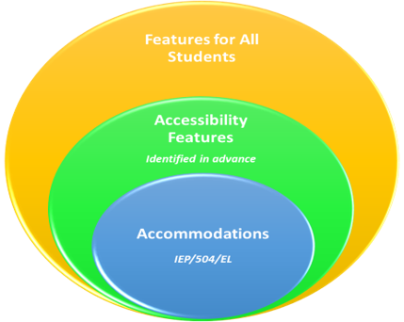
Accommodations and Accessibility Features
Features for All Students
TestNav tools available to all students
Administration Considerations
Testing environment
Accessibility Features
Answer mask / color contrast
Accommodations
Requires IEP/504 or EL plan
Test Coordinators will need to confirm that the correct accommodations have been added to the students’ record by viewing the student details in ADAM and update as needed.

Slide 26
Accommodations and Accessibility Features
CBT Accessibility Feature examples (TestNav)
These are available to all students:
Line Reader
Answer Eliminator
Magnifier
Highlighter
Bookmark
Pop-up glossary
Notepad
Blank Scratch Paper*
*After testing Test Administrators are responsible for collecting ALL scratch paper after testing has completed to be securely destroyed.

Slide 27
Accommodations and Accessibility Features
Administration Considerations examples*
These should be identified in advance of testing:
Adaptive and Specialized Equipment or Furniture​
Frequent Breaks​
Small Group Testing​
Specified Area or Setting​
Separate or Alternate Location​
Time of Day​
*These do not need to be captured on the student accommodation file.

Slide 28
Accommodations
Accommodation form specific examples**
Computer Based:
American Sign Language
​Assistive Technology (Screen Reader or Non Screen Reader)
Closed Caption
Read Aloud / Human Reader
Text to Speech
Paper Based:​
Braille​
Large Print
Paper
*Students cannot have multiple form specific accommodations.
*Accommodations MUST be updated on the student record in ADAM and require an IEP/504 or EL plan.

Slide 29
Accommodations and Accessibility Features
Differences between Text-to-Speech, Human Reader/Oral Script, and Screen Reader
Text-to-Speech (TTS) – Computer reads the content via the TTS functionality. This is not for blind or low-vision students.
For Math:
Text with graphics - reads all printed text and the hidden alternate text descriptions for images.
Text only - reads printed text but does not read any alternate text descriptions for images.
ELA only uses text with graphics.
Screen Reader – for visually-impaired students using a program that reads the screen and read Braille (e.g., JAWS)
Human Reader/Oral Script – assessment is read aloud by test administrator (CBT or PBT)
Math must use the provided script.
ELA requires an approved accommodation (No script provided) due to testing the student’s reading ability.

Slide 30
Accommodations for ELs
English Learner Accommodations
Extended Time
​Word-to-Word dictionary
Human Signer for Math
General Admin Directions Read Aloud, Clarified and Repeated in Native Language

Slide 31
Before Testing Tasks
31

Slide 32
LaunchPad SSO & ADAM
32

Slide 33
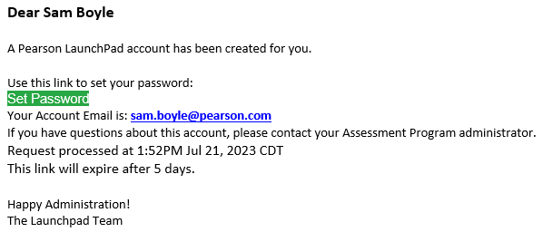
LaunchPad Welcome Email
LaunchPad is a new Pearson offering that will act as a single sign-on (SSO) for all Pearson testing products used by the BIE, including ADAM. A welcome email from LaunchPad System will be sent with a link to set your password.

Slide 34
LaunchPad – New Users
Once new users are added into LaunchPad they will be sent a welcome email with a link to set their password.
When a new selects the link they will be asked to update to a password of their choosing. Links expire after 5 days.
After successfully logging into LaunchPad, users will be able to select ADAM from the available application tiles.
If you do not have LaunchPad access, please contact the BIE.

Slide 35
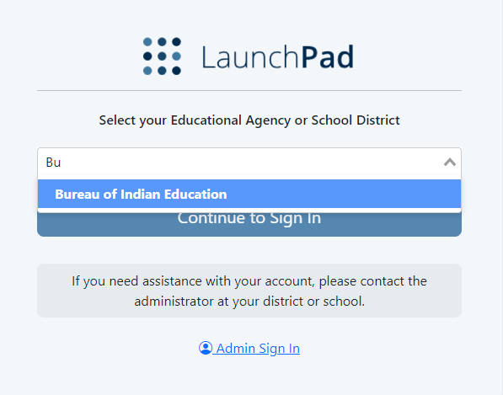
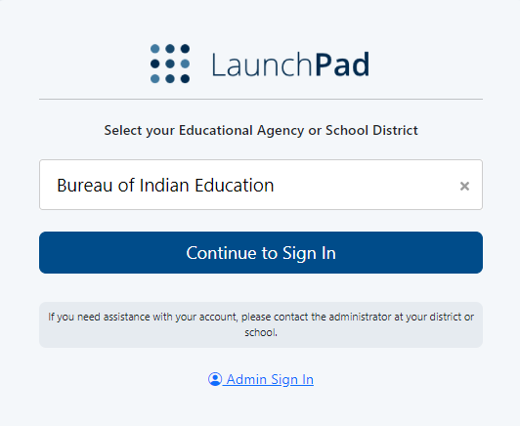
LaunchPad Login
Once a password has been set, to login to LaunchPad navigate to https://launchpad.pearson.com/#, select Bureau of Indian Education from the Educational Agency or School District list, then select Continue to Sign In.

Slide 36
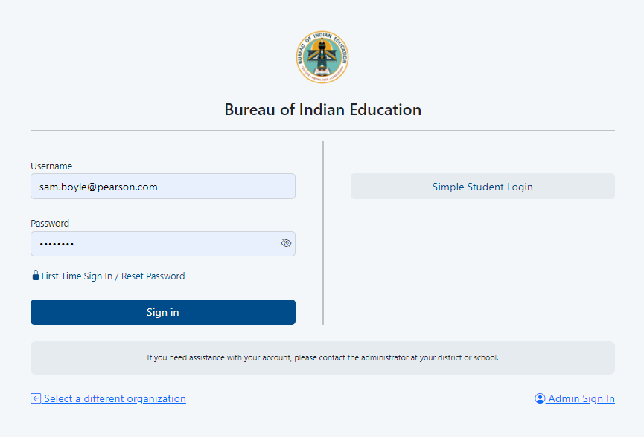
LaunchPad Login
On the Bureau of Indian Education sign in screen, enter your username & password and select Sign In.

Slide 37
LaunchPad
Once logged in to LaunchPad, select the ADAM tile from the available apps, and you will automatically be logged into ADAM.

Slide 38
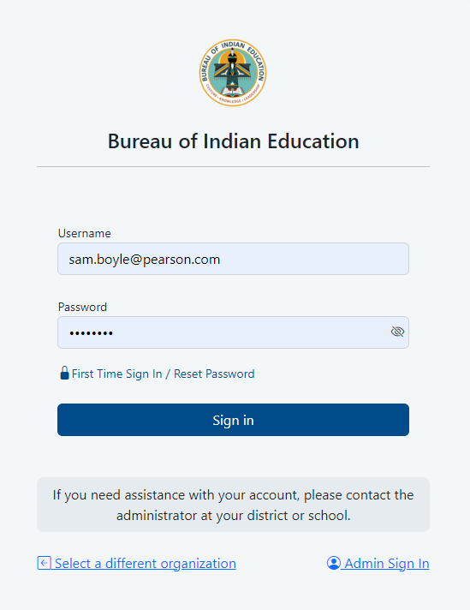
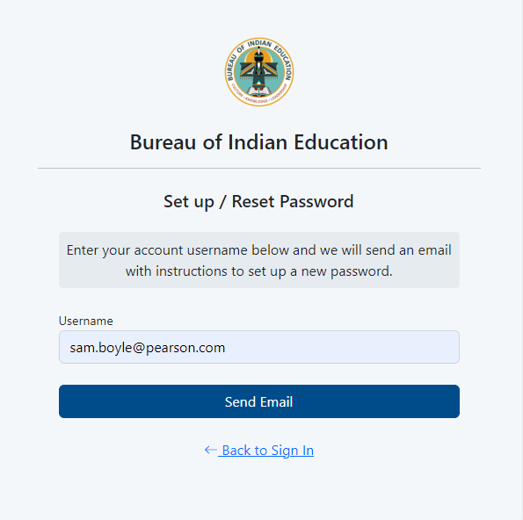
LaunchPad – Forgot Password
If you are having issues logging in use the reset password link.

Slide 39
Accessing LaunchPad
Users can easily access the LaunchPad SSO link at https://bie.mypearsonsupport.com.

Slide 40
ADAM
ADAM is the test management platform used to administer Summative assessments.
ADAM allows users access to the Summative and Training administrations and is also used to create proctor groups and print student test tickets, which students will use to login into the assessment application TestNav.
ADAM is also the platform for accessing student assessment results and reports. More information on results and reporting will be provided later in the training.

Slide 41
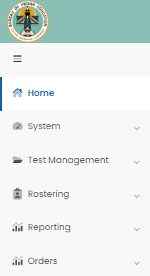
ADAM Menu
Home – Main landing page where Bulletins, including announcements, will be posted.
System – User Profile information can be accessed here.
Test Management – Available test administrations & practice tests can be accessed and administered here.
Rostering – Academic sessions information and Users information can be accessed here.
Reporting – Available reports can be viewed and downloaded here.
Orders – Additional Orders can be placed and tracked here.

Slide 42
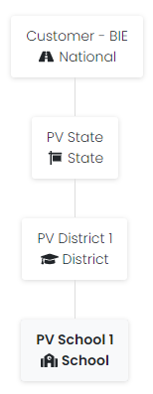
ADAM Menu
The ADAM menu view is based on the User role and assigned Org (School). User Profile information and Org Chart can be reviewed by selecting System, then Profile.

Slide 43
ADAM User Roles
School Admin – principal and/or assistance principal
Test Coordinator
Information Technology – formerly System Administrator
*Teacher
*Test Administrator
*NOTE: Any User that administers tests to students in ADAM is considered a proctor. An active User role in ADAM is not required to proctor/administer a test, only a valid Test Code and Proctor Password provided by the school Test Coordinator. Staff proctoring a test in ADAM will use the credentials provided by their Test Coordinator to login at https://ltr.adamexam.com/#/proctor.

Slide 44
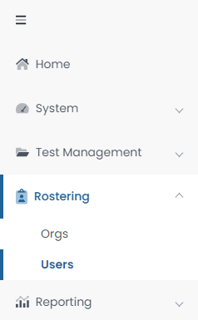
Verifying Users in ADAM
Click on Rostering in the menu then click Users and you will see a list of users, email addresses, and last login status in your organization. If a user’s last login status shows Never, that means they have not yet accessed the platform. If someone is not on the Users list who should be, please contact the BIE.

Slide 45
User Imports in ADAM
The BIE & Pearson will be making regularly scheduled file imports of user data (both students & non-student users) every 2 weeks. All Student and non-student User information will be pulled from NASIS.
These user imports will include:
New students and school staff.
Student transfers (school to school or district to district).
Data updates (DOB, name, demographic information).
Accommodations will NOT be update via user imports, it is the responsibility of the school Test Coordinator to update in ADAM.

Slide 46
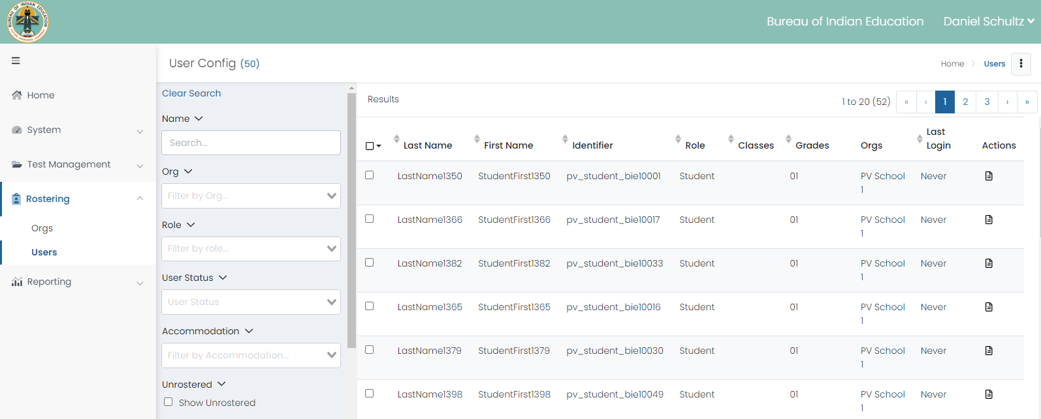
View Roster Data

Slide 47
ADAM – Students
Viewing Student Demographics
On the Users screen, you will be able to view the list of Students uploaded to ADAM.

Slide 48
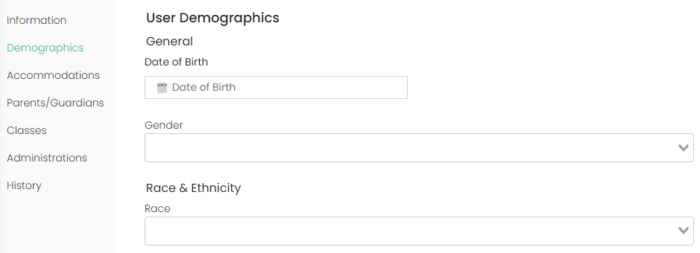
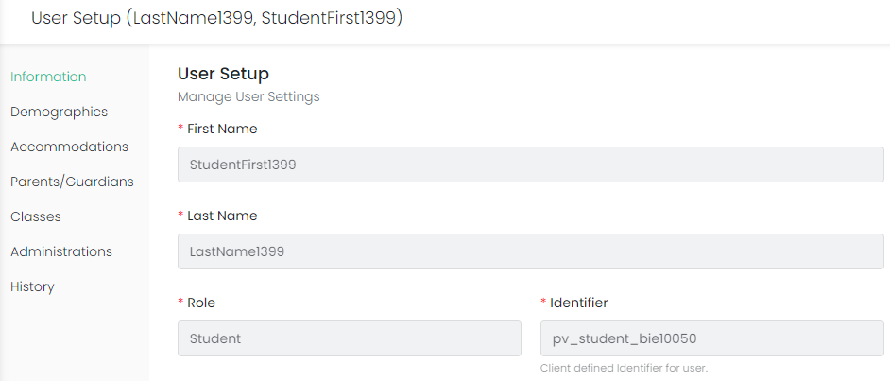
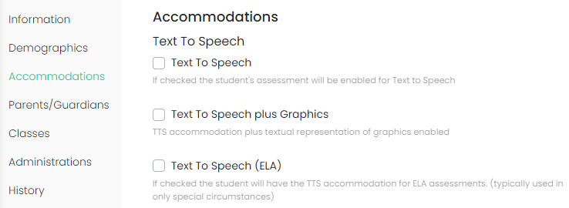
Student User Setup Page
Users with the Test Coordinator role will have access to student details and can use the User Setup screen to view demographic information and confirm and update accommodations.

Slide 49
ADAM User Information
BIE will create User profiles for School Administrators, Test Coordinators, and IT staff.
User profiles in ADAM are managed by the BIE & Pearson via LaunchPad.
User email cannot be changed. If there is a change in email a new user account will need to be created.
Staff serving as a test administrator/proctor will NOT have a user profile in ADAM, as a profile is not required to proctor tests.

Slide 50
ADAM – Export Users
Select Rostering
Select Users
Select the specific student and/or non-student users for export
Click the kabob menu in the upper right and select Export Selected Users

Slide 51
ADAM – Verify & Update Students
All students MUST have accommodations updated by February 9, 2024, in ADAM.
This is very important, as this data drives the initial orders sent to your schools for online and paper tests, manuals, and accommodated materials.
BIE will be responsible for student import; Test Coordinators need to verify the following:
Verify all student data loaded is accurate.
Update or add student accommodations.

Slide 52
ADAM – Online Accommodations Available
Accommodation | ELA/Math | Paper/Online
American Sign Language | Both | Online
Assistive Technology (Screen Reader) | Both | Online
Assistive Technology (Non-Screen Reader) | Both | Online
Closed Captioning | ELA | Online
Read Aloud / Human Reader | Both | Online/Paper
Human Signer | Both | Online/Paper
Text To Speech | Both | Online
Student must have a 504 or IEP for assigned accommodations

Slide 53
ADAM – Online Accommodations Available
Accommodation | ELA/Math | Paper/Online
Braille plus Tactile Graphics | Math | Online Test & Paper Tactile Graphics
Refreshable Braille | Both | Online
Answer Masking | Both | Online
Color Contrast | Both | Online
Student must have a 504 or IEP for assigned accommodations

Slide 54
ADAM – Paper Accommodations Available
Accommodation | ELA/Math | Paper/Online
Braille​ | Both | Paper
Large Print | Both | Paper
Paper | Both | Paper
Student must have a 504 or IEP for assigned accommodations

Slide 55
ADAM – Accommodated Forms Hierarchy
Students with multiple accommodations will be assigned to a form that supports all, or most of their form determinant accommodations as outlined below.
Online Form Assignment Order | Paper Form Assignment Order
Braille Tactile Graphics Human Signer American Sign Language (ASL) Refreshable Braille / Assistive Technology Closed Caption Text to Speech (TTS) Human Read Aloud Assistive Technology (Screen Reader) Assistive Technology (Non-Screen Reader) Large Print | Paper Braille Tactile Graphics Human Signer Read Aloud / Human Reader Large Print

Slide 56
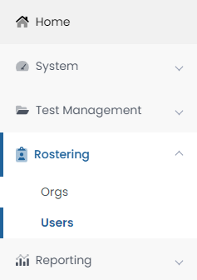
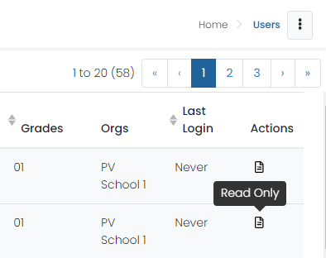
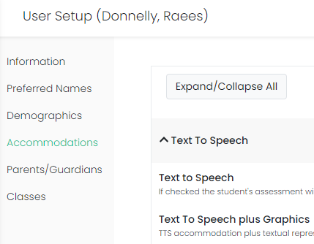
Assigning Accommodations in ADAM
School Test Coordinators will be responsible for applying student accommodations prior to testing. Accommodations can be applied to the Student record or in bulk via a data import using the Student Accommodation Upload option.

Slide 57
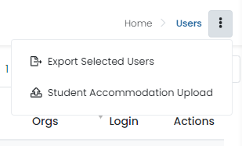
Student Accommodation Upload in ADAM
Select Rostering, then select Users.
Search for the students you want to view or update (set the Role filter to "Students"). You can search for all the students in a school or a single grade.
Select the checkbox in front of each student you want to update. You can select the checkbox at the top of the list to select all students in the search results or on the current page.
Select the ellipses on the top right, then select Student Accommodation Upload.
Follow the on-screen instructions on the Student Accommodation Upload and Update Students via CSV page.

Slide 58
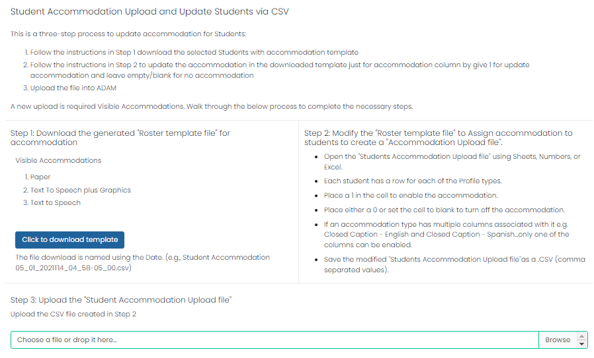
Student Accommodation Upload in ADAM

Slide 59
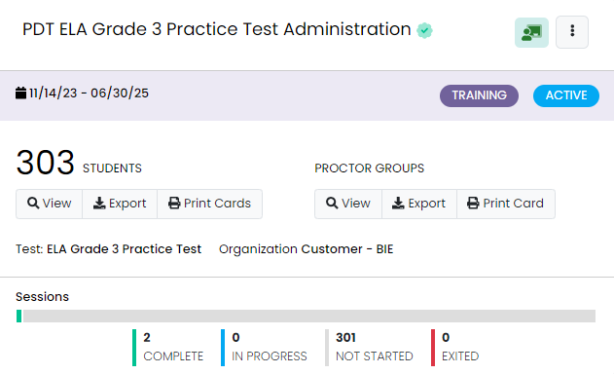
Test Administrations in ADAM
Test administrations will be set up in ADAM by Pearson. BIE Principals, school Test Coordinators, and IT staff will be able to view the admins.
Administrations in ADAM feature two sections:
Students – a list of all eligible students for a particular test.
Proctor Groups – view or create testing groups.
Sessions – view student progress.

Slide 60
Training Administrations in ADAM
Training administrations are available by navigating to Test Management, then Training Administrations. These training admins can be used for practice tests and for the optional Infrastructure Trial.

Slide 61
Proctor Groups
Proctor groups in ADAM are groupings of students, created by school Test Coordinators, that will be testing together and/or be tested by the same test administrator or proctor.
Students can be grouped by:
Class
Administration consideration (i.e. small group)
Subject (i.e. Algebra I)

Slide 62
Proctor Groups – Paper-based Testing
Students who will be testing Paper DO NOT need to be added to a proctor group in ADAM.
Proctor groups in ADAM are for computer-based testing only.
All Paper-based testing students will need is the Paper accommodation applied to their record in ADAM.

Slide 63
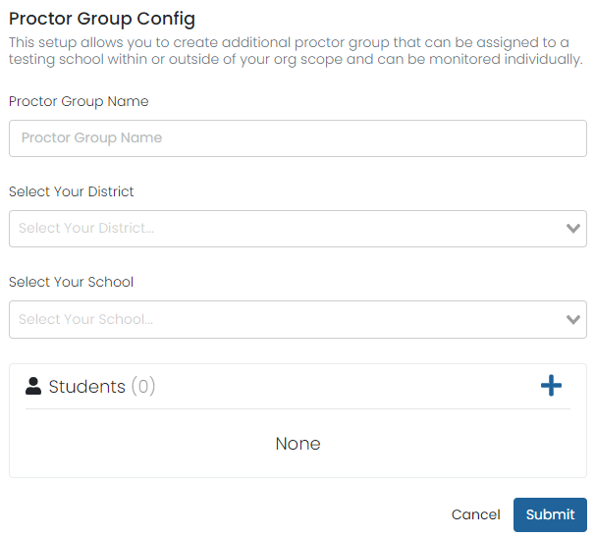
Creating Proctor Groups
When you first open View Proctor Groups all students will be assigned to the Unassigned proctor group.
To create a new proctor group:
Select Create Proctor Group.
Complete the form for each proctor group you are creating.
If you’re assigned students, click the + button and then select students to assign to the proctor group.
Click Submit to save the new proctor group.
Once proctor group(s) are created the Test Coordinator can then provide each proctor with the unique test code and password for proctor login.

Slide 64
Proctor Group Upload
As an alternative to creating each proctor group in the ADAM user interface (UI), Test Coordinators can also use the Upload Proctor Group option to create proctor groups through a bulk file upload.

Slide 65
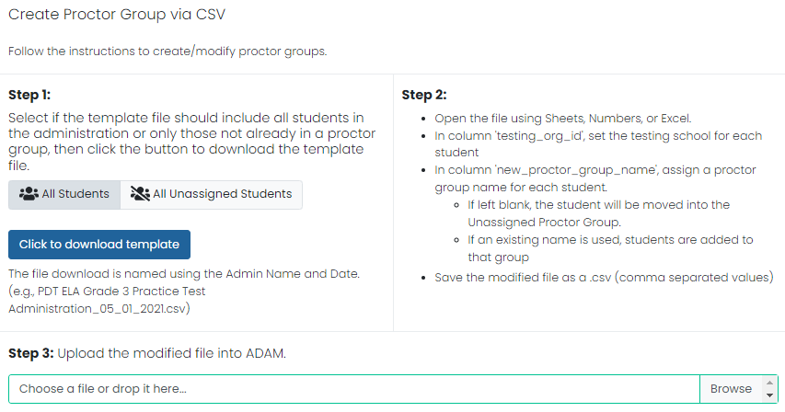
Proctor Group Upload
After selecting Upload Proctor Group, you’ll be taken to a new screen that provides step-by-step instructions on downloading the template file, updating the file, and uploading into ADAM.

Slide 66
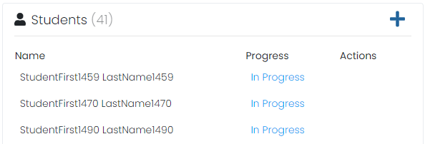
Add Students to Existing Proctor Groups
Go to Test Management and select Administrations.
In the appropriate administration card, select View under Proctor Groups.
Select Students under Actions.
Select Edit Proctor Group.
Select the + icon to assign additional students.
66

Slide 67
Student Registration
Go to Test Management, then select Administrations.
On the proctor dashboard, it shows the total registered student count for the administration.

Slide 68
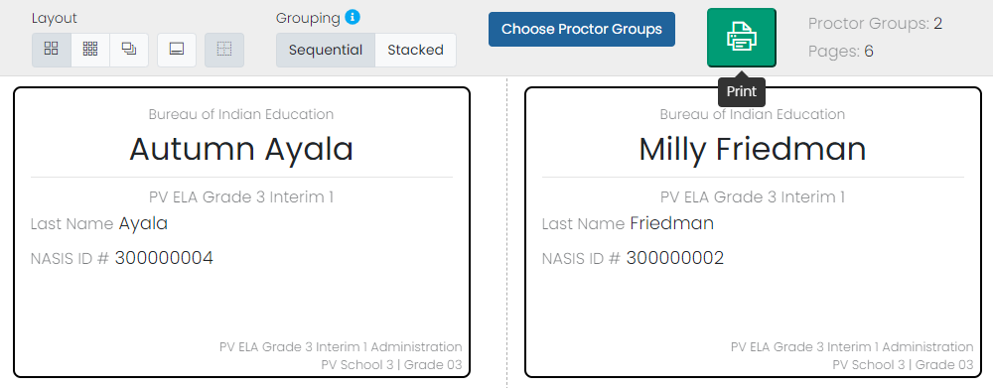
Printing Test Cards
Locate the administration card, and then select Print Cards.
You can select various formatting options:
Layout - Select 2 by 4, 3 by 6, or 1 per page.
Toggle title pages for each proctor group - Select whether to include title pages for each proctor group. This prints a roster for the proctor.
Toggle borders - Select whether to include dashed borders (guides for cutting the cards).
Grouping - Sequential or Stacked. Select the information icon to see formatting conventions for each option.
Select the Print button.

Slide 69
Before Testing Checklist
69

Slide 70
Before Testing – Test Coordinator Tasks
Confirm that the TestNav app has been downloaded for all devices.
Confirm that all devices can connect to the school network.
Unpack Secure and Unsecure test materials.
Ensure students have completed practice tests, as needed.
Review the Test Coordinator Manual and Test Administration Manuals.
Review the Accessibility Features and Accommodations Manual (AF&A).
Train teachers and staff on testing expectations.
Print student testing tickets.

Slide 71
Test Security
Materials are kept in a central, secure, and locked location with limited access.
No duplication of secure materials is permissible.
All involved personnel understand security protocols.
All involved personnel have signed security agreements. (https://bie.mypearsonsupport.com/training-resources/).
Test environments are secured against unauthorized personnel.
Use a chain of custody (https://bie.mypearsonsupport.com/training-resources/).

Slide 72
Test Materials Security
Secure
Student testing tickets
Paper-based test booklets
Answer documents
Human Reader scripts
Used scratch paper
Any student work/responses
Mathematics Reference Sheets prior to testing
Any material written on that cannot be reused
Non-Secure
Test Administrator Manuals (TAM)
Test Coordinator Manual
Unused scratch paper

Slide 73
Testing Materials – Initial Shipment
Initial materials will be received 1-2 weeks prior to the test start date.
You MUST have all student accommodations in ADAM by February 9, 2024, to ensure you receive the appropriate testing materials.

Slide 74
Testing Materials – Initial Shipment
Test Coordinator Kit
Resealable plastic bag (holds all materials)
Paper bands
Pearson Scorable and Nonscorable labels (2 different colors)
UPS Ground return labels for Scorable and Nonscorable materials
Pre-printed/pre-gridded test booklet
Student ID labels and roster
Return instructions sheet
Shipping carrier return instructions
Packing list and chain of custody form
Test Coordinator Manual
Test Administrator Manuals
Student Test Materials
Test booklets/answer documents
Math Reference Sheets, rulers, and protractors, if applicable
Large Print/Braille kits
Human Reader kits

Slide 75
Testing Materials – Initial Shipment
Accommodation | Students testing Online | Students testing Paper
Text to Speech | Student receives a form that has text to speech tools available. No other materials are needed for the student. | N/A
Human Signer - Math | Human Reader/Signer script is shipped to school that includes same questions as the online human reader test. | A Human Reader/Signer Kit is sent to school. Kit contains: Student test book, student answer document, ruler-protractor-math reference sheet as needed, a math human reader script.
Human Signer - ELA | N/A | A Human Reader/Signer Kit is sent to school. Kit contains: Two (2) Student test books, student answer document.
Human Read Aloud - Math | Human Reader/Signer script is shipped to school that includes same questions as the online human reader test. | A Human Reader/Signer Kit is sent to school. Kit contains: Student test book, student answer document, ruler-protractor-math reference sheet as needed, a math human reader script.
Human Read Aloud - ELA | N/A | A Human Reader/Signer Kit is sent to school. Kit contains: Two (2) Student test books, student answer document.

Slide 76
Testing Materials – Initial Shipment
Accommodation | Students testing Online | Students testing Paper Sessions
American Sign Language | Student receives a test form with embedded videos of American Sign Language. | N/A
Closed Captioning (ELA only) | Student receives a test form with closed captioning and a transcript for any included videos. | N/A
Refreshable Braille Display | Student receives the assistive technology non screen reader form. | N/A
Assistive Technology Screen Readers | Student receives the assistive technology screen reader form and a Braille kit will be sent to the school for the student. | N/A
Braille Tactile Graphics | Student receives the assistive technology screen reader form and a Braille kit will be sent to the school for the student. | N/A
Large Print | N/A | A Large Print Kit is sent to schools. Kit contains: Student test book, student answer document, ruler-protractor-math reference sheet as needed, a math human reader script.
76

Slide 77
Receipt of Materials
Upon Receipt of Test Materials, Test Coordinators should:
Remove the Packing List, chain of custody Form, and Test Coordinator Kit from Box 1.
Inventory materials immediately to verify that all were received and that there is an adequate number for administration.
Count the number of shrink-wrapped packages only. Shrink-wrapped packages may be opened four school days before testing.
Optional: take labels out of School Coordinator Kit
Test Coordinators may order additional material, if necessary.
Keep all test materials in a centrally locked storage area, with limited access, until testing.
Ensure that chain of custody procedures are always followed.

Slide 78
Receive Materials & Chain of Custody Forms
Document any movement of secure materials before, during, and after testing.
Schools inventory materials using the chain of custody.
Deliver paper-based forms and materials (oral scripts) to Test Administrators only on the day of testing, using a chain of custody process.
Distribute only the content area being assessed.
As close to testing time as possible
Return materials to a designated secure location.
Not stored in classrooms
As soon as possible after the unit is complete
Test Administrators return secure materials to Test Coordinator after testing is completed, including Math Human Reader scripts.

Slide 79
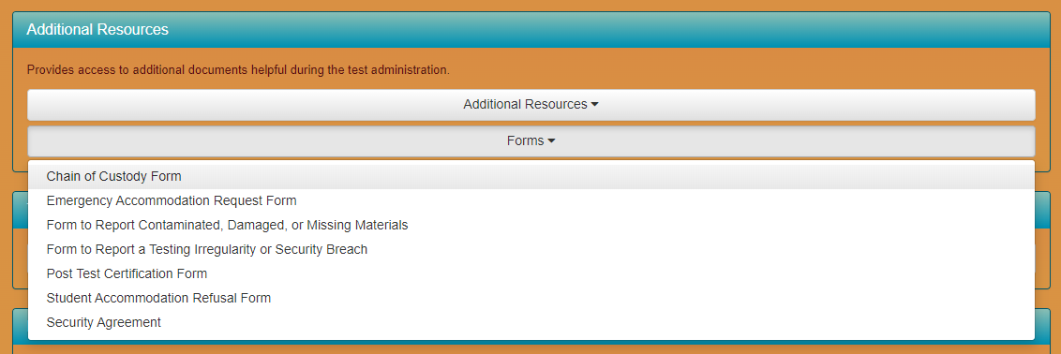
Chain of Custody Forms
Use a new school chain of custody form for each day of testing the form must include:
Security barcode/number
Test Administrator signature
Date and time checked out
Test Coordinator (or designee) signature for return
Date and time returned
Chain of custody forms are kept on file for three years. If materials are missing, these will be requested.

Slide 80
Documenting and Storing Test Materials
Keep all boxes in which the test materials were delivered and use them to return Scorable and Nonscorable materials after testing is completed.
Report the following occurrences immediately to BIE using the Form to Report Contaminated, Damaged, or Missing Materials (see Appendix E of Test Coordinator Manual):
Non-receipt of any materials listed on the School Packing List
Discovery of damaged test material
Discovery of missing or duplicate sequence numbers on any Test Booklets

Slide 81
End of Session 1: Administration Overview & Before Testing Tasks
81

Slide 82
Session 2: During Testing Tasks
82

Slide 83
Additional Order Window
Spring Additional Order (AO) window:
Order at least 5 days prior to test administration, but after the initial order is received.
It is the school Test Coordinator’s responsibility to understand the additional order window and process.
Component | Dates
Additional Order window | March 4 – April 25, 2024
Return Materials (Secure) | April 26, 2024
Return Materials (Non-Secure) | May 3, 2024

Slide 84
Additional Orders
Orders can be only be submitted in ADAM by the test coordinator.
BIE will only approve additional orders for accommodated materials if the ordered materials can be matched to a student registration in ADAM.
The accommodations information must be entered on the student's profile before placing the additional order.

Slide 85
Additional Orders
Keep in mind when ordering additional material:
Do not submit AOs prior to receiving the initial shipment of test materials.
PreID labels for paper tests will NOT be sent with AOs.
All test materials should be inventoried prior to placing an AO.
Once an AO is approved, please allow 4-5 business days for shipment delivery.

Slide 86
Additional Orders
Keep in mind when ordering additional material:
Ancillary materials for return shipping are not automatically included in the AO.
Shipping labels
Mathematics tools and Reference Sheet
Account for the need of these additional materials when an AO is placed.
Check for return labels prior to the end of the testing window as these will not have expedited shipping.

Slide 87
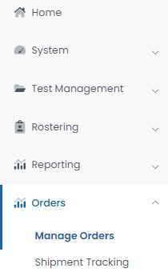
Creating Additional Orders
To place an additional order in ADAM:
Select Orders, then select Manage Orders.
Select Create Order
Fill out all required information for the new additional order on the Order Details screen, then select Go to Order Items.
Add all needed items and item quantities, then select Go to Confirm Order.
Confirm the details and items for your additional order, then select Approve Order.

Slide 88
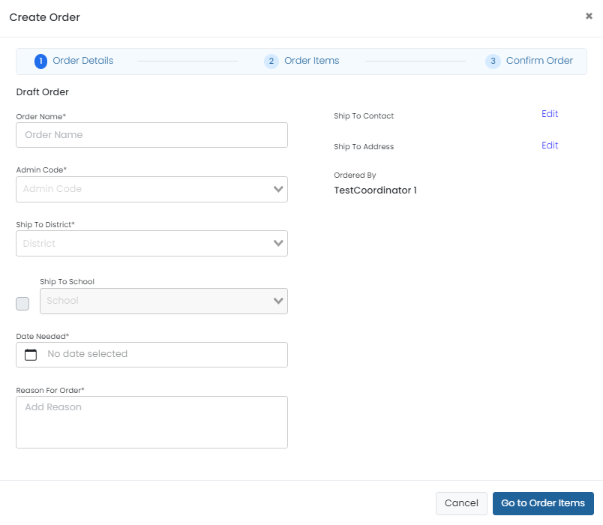
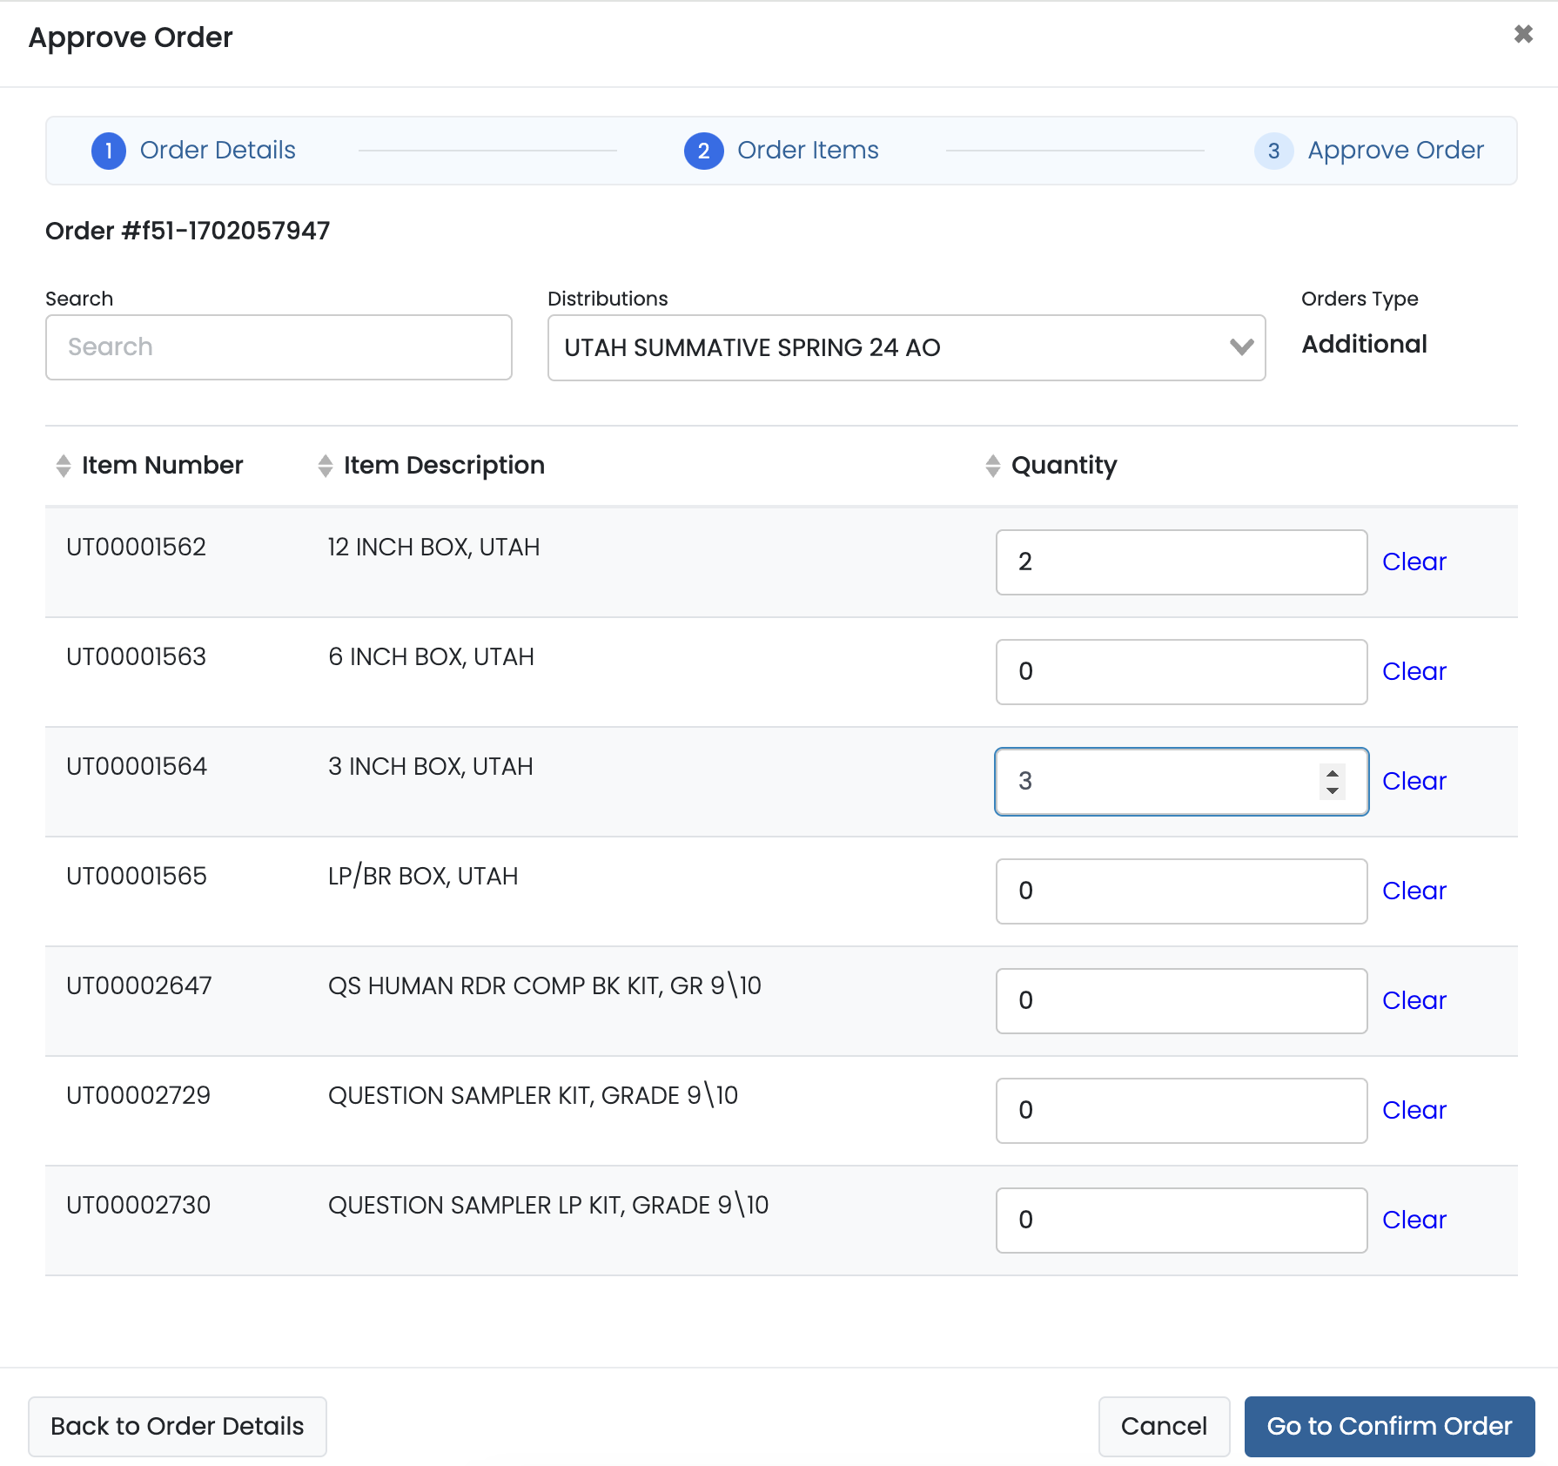
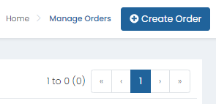
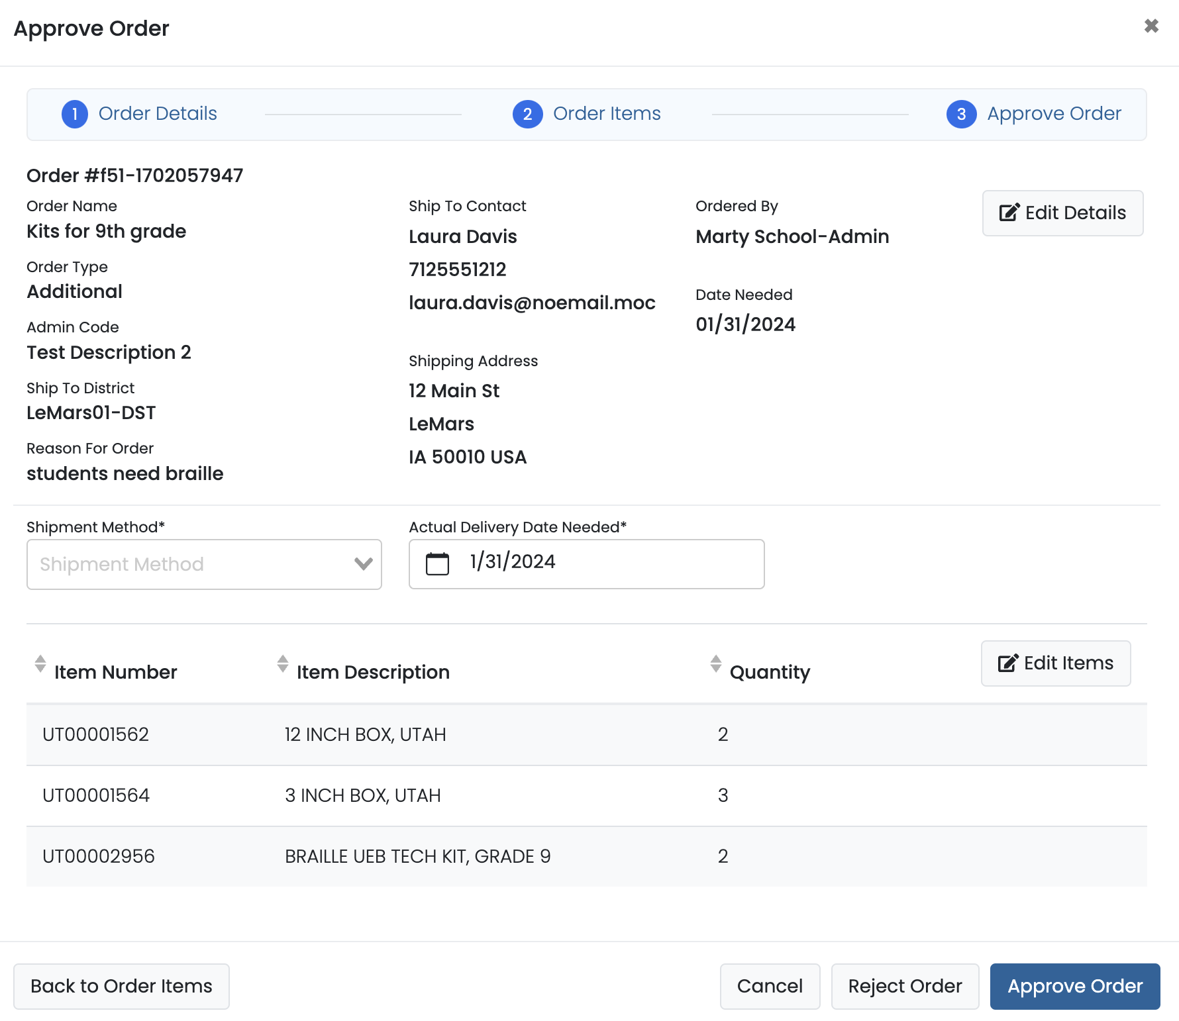
Creating Additional Orders

Slide 89
Student Transfers
If a student has transferred into your school and you do not see the student in ADAM, contact BIE to process the student transfer in LaunchPad.
BIE will need to know the student NASIS ID, date of birth, and the schools the student transferred from and to.
You can also create a temporary student in ADAM to allow the student to test and merge to the permanent student record once the student is transferred.
If a student has an existing Online test in an In Progress, Exited, or Resumed status, wait until the student has transferred in ADAM before resuming testing

Slide 90
Proctoring in ADAM
Any school staff proctoring (administering) Summative tests in ADAM will NOT require a user profile in LaunchPad.
Test administrators, teachers, and any staff proctoring tests will access the ADAM proctor dashboard by logging in at https://ltr.adamexam.com/#/proctor.
The proctor dashboard will allow proctors to begin student tests, monitor student progress, create temporary student records as needed, and update student statuses as needed.
Test Coordinators will also be able to access proctor dashboards for all proctor groups created at their school.

Slide 91
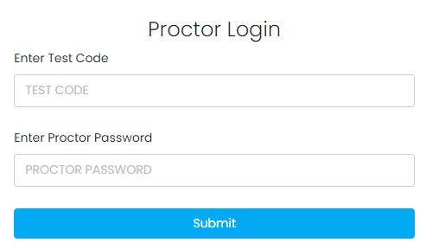
Proctor Login
Navigate to https://ltr.adamexam.com/#/proctor.
Enter the test code & proctor password (provided by the test coordinator).
Select Submit.

Slide 92
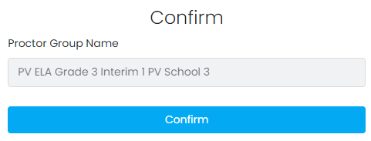
Proctor Login
Select Confirm on the next screen.
Type your proctor first name & last name.
Select Save.
Proctor dashboard will then load.

Slide 93
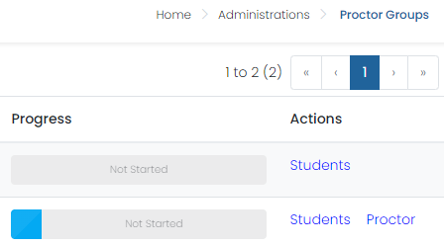
Monitor Proctor Groups
School Test Coordinators can monitor student testing status by selecting View under Proctor Groups on the admin card, then selecting Proctor under Actions for a particular proctor group. This will take you to the proctor dashboard for that proctor group.

Slide 94
During Testing – ADAM Proctor Dashboard

Slide 95
Proctor Dashboard Details
Assessment Information – Here you can view information about the test, test configuration, and select an action.
Testing Information – Includes Test, Administration, and Proctor Group
Config Information – Includes Test Window, Proctor Name, and Kiosk Only field
Actions – Includes Test Code, Proctor Password, and Print Cards link
Student Session List – Here you can view, filter, search for students in your proctor group and manage their sessions, and apply accountability codes as needed. Students that can access the test appear in the Tester column.

Slide 96
During Testing – Progress Status
The progress column displays the students’ progress as one of the following:
Not Started – The student has not signed in to test.
In Progress - The student has signed in to the test. No action is needed by the proctor.
Submitted - The student has completed the test and submitted their answers.
Reseat – The proctor has reseated the student(s). The student has not yet signed back in to the session. No action is needed by the proctor.

Slide 97
During Testing – Health
Health tells the proctor if the student is interacting with the test. Health can display one of the following values:
Not Started – The student has not signed in to the test. No action is needed by the proctor.
Submitted - The student has completed the test and submitted their answers.
Exited - The student has exited TestNav, and a proctor must reseat them before they can log in to the test again.
Resumed – The student has resumed their test session.

Slide 98
During Testing – Actions
After the assessment session has started, a set of buttons appears in the Actions column for each student. Proctors use these buttons to control individual student’s sessions:
Reseat Session – Proctors can select this if a student exits TestNav before submitting their test or if something interrupts a student's session. This might include a computer issue, session timeout, or an unexpected error. Reseating allows the student to re-enter their test code and SSID to continue taking their test.
Submit Session - Proctors can select this if a student finishes their test but does not submit the test before exiting.
Unsubmit Session - Proctors can select this if a student mistakenly submits their test.

Slide 99
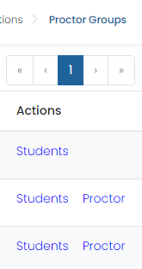
Adding Students to Existing Proctor Groups
To add students to an existing proctor group in ADAM:
Navigate to the proctor group where the student will test.
Select Students under the Actions column.
Select Edit Proctor Group.
In the Students section select + (Add) to add any additional students, then click Close.
Click Submit to save changes.

Slide 100
Temporary Student Records
If a student enrolled at your school does not have a record in ADAM, a temporary record will need be created in the proctor dashboard.
A temporary record will need to be created for each test the student takes.
When creating a temporary record, a unique ID will need to be applied.
Pearson recommends using the student’s NASIS ID + a unique identifier (i.e. NASIS ID – 123456789 + G3Math).
Once a permanent record has been created in ADAM for the student, all temporary records will be merged to the permanent record by the BIE.

Slide 101
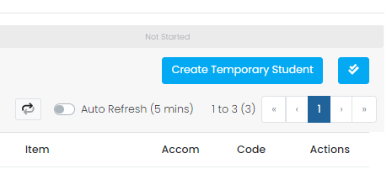
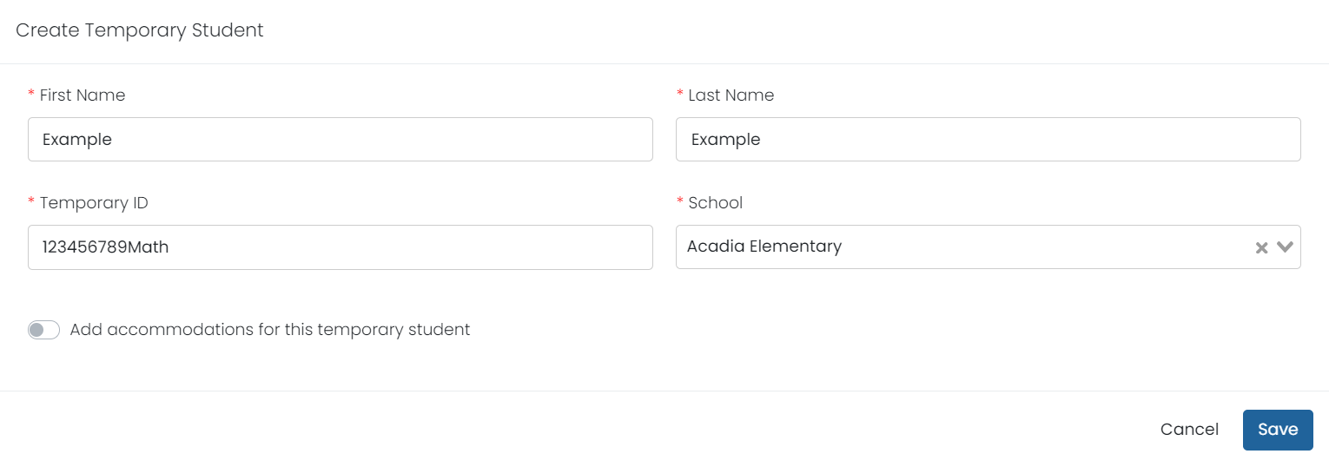
Creating Temporary Students
To create a temporary student record in ADAM:
Navigate to the proctor dashboard where the student will test.
Select Create Temporary Student
Add the students First Name, Last Name, Temporary ID, and School.
If applicable, select Add accommodations for this temporary student and add all needed accommodations.
Select Save.

Slide 102
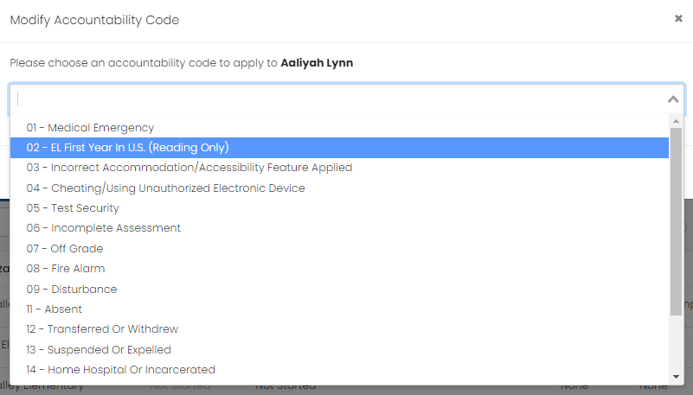
Accountability Codes
This proctor dashboard feature provides a way to note a testing situation for a student that was not expected, such as a medical emergency or withdrawal.

Slide 103
TestNav
103

Slide 104
TestNav Updates
TestNav 8.22 Global Core Changes – Not configurable, part of base product
Updated to allow students to copy text from passages and paste it into response entry areas of the user interface (UI).
Added ARIA labeling to volume display and controls for better screen reader support.
Eliminated auto-scrolling of content out of the display area when dragging a match interaction dragger past the edge of the content in a two-pane-scrolling item.

Slide 105
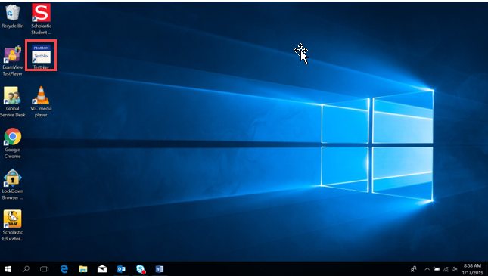
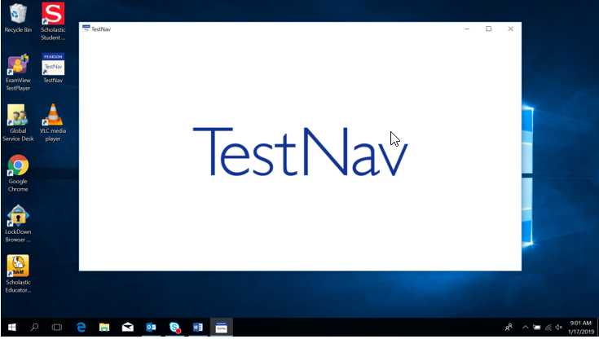
TestNav – Student Access on a Windows device
Select the TestNav icon from the desktop.

Slide 106
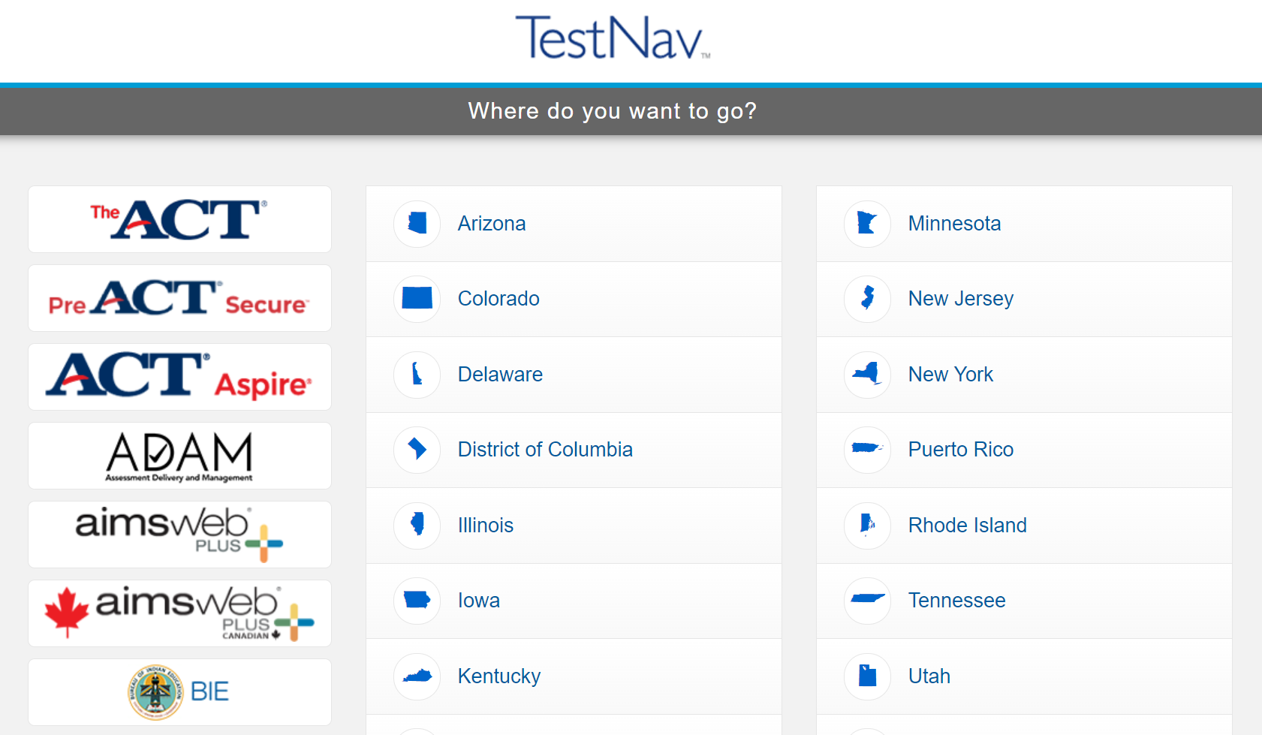
TestNav Access
If not already chosen, students will need to select BIE from the customer list.

Slide 107
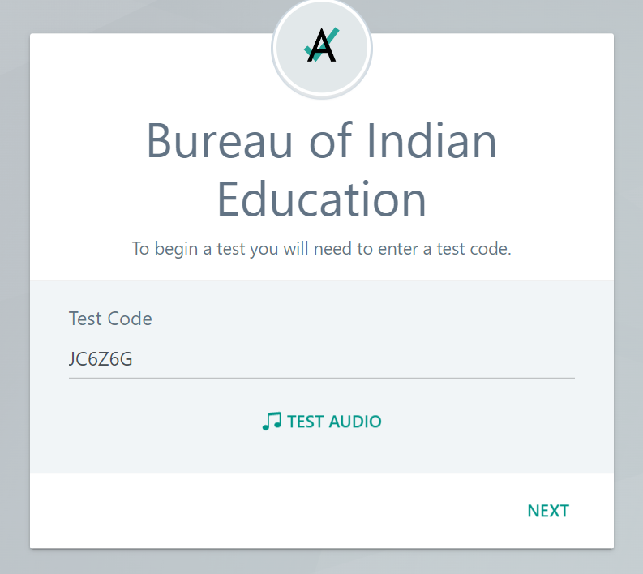
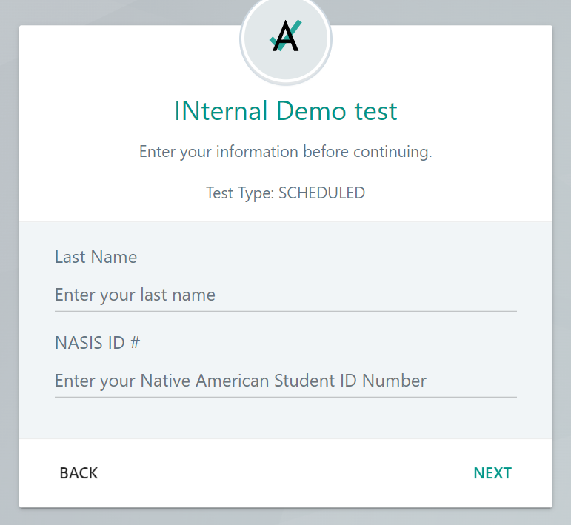
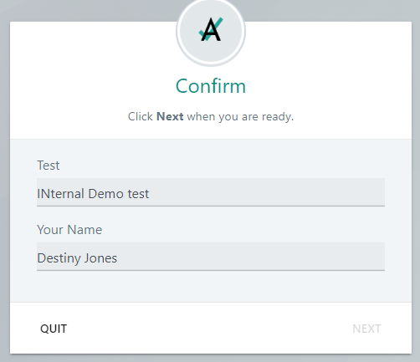
TestNav Sign-In
Students input the Test Code provided by the proctor & Last Name and NASIS ID from their test ticket. The student will then confirm the information is correct and select next to begin their test.

Slide 108
During Testing Checklist
108

Slide 109
Test Environment – Student-to-test Administrator Ratio
Student-to-Test Administrator ratio must not exceed 30 to 1.
Test Administrator must be able to actively monitor the space within the physical testing environment.
Test Administrators must:
Actively proctor.
Remain attentive and in the room during the entire testing unit.
Circulate throughout the room during the test.
See students working, but not student work.

Slide 110
Test Environment
The testing environment must:
Be adequately lit, quiet, free of distractions, and heated or cooled.
Provide an adequate writing surface (paper-based).
Be free of electronic devices and music.
“Do Not Disturb/Only Authorized Personnel Allowed” sign must be placed on the door during test sessions.

Slide 111
Test Environment
No food or drinks are allowed on desks or near test materials.
The testing environment must be free of any content related posters or aids that suggest possible answers to students:
Word walls.
Steps for solving math equations.
Any content related materials.
Any resource that defines, explains, or illustrates terminology or concepts.
General rule: When in doubt, cover it.

Slide 112
Test Environment – Display Testing Time
Display unit testing time for students as in the example below:
Unit Name: | Algebra 1, Unit 1
Unit Testing Time: | 90 Minutes
Starting Time: | 9:00
Stopping time: | 10:30

Slide 113
Room Configuration
Students should not be able to see each other’s work from a normal testing position.
Consider the following seating configurations to maintain test security:
Seat students in every other seat (useful in a computer lab setup).
Arrange monitors back-to-back.
Seat students back-to-back.
Seat students in a semicircle (useful for schools using laptops).
Seat students in widely spaced rows or in every other row (appropriate for a classroom setup).
Dividing screens or other privacy materials may be used if students cannot be placed far enough away from each other.

Slide 114
Headphones – Computer-based Testing
ELA:
All students must have headphones for all units.
Not every unit has sound, but one unit for each student will.
Students should be prepared follow directions and adjust sound for each unit.
Text-to-Speech for ELA & Math:
To be in a testing room with other students, headphones must be worn.
Students must be tested separately if they are not able to wear headphones.
Math:
Does not contain audio, unless text-to-speech is used.

Slide 115
Unauthorized Visitors and the Media
Only students, Test Administrators/proctors, and authorized school, district, state personnel, or state-sanctioned test monitors may be in testing areas during administration.
Media are not allowed to have access to the tests before, during, or after test administration, or take pictures or video of testing materials or testing students.
Parents are not allowed in the testing room with their child.

Slide 116
Day of Testing – Test Coordinator Tasks
Complete the Day of Testing Checklist
Distribute test materials.
Ensure Test Administrators have a computer device to administer the test.
Monitor test activity.
Be available to Test Administrators.
Collect materials from Test Administrators after each test, as needed.

Slide 117
Day of Testing – Test Administrator Tasks
Before Testing:
Prepare the test environment and situate the students.
Follow directions and read the script in the Test Administrator Manual (TAM) to initiate the test session.
Hand out student test tickets and scratch paper when directed (by the TAM script).
Assist students in logging into TestNav.
After Testing:
Collect student testing tickets and scratch paper.
Confirm students have logged out of TestNav.
Confirm ALL tests are in a Submitted status after final day of testing.

Slide 118
During Testing – Active Monitoring
Test Administrators/Teachers should:
Ensure students have all necessary materials for each test.
Follow test administration scripts exactly as written.
Move throughout the room during testing to ensure students are on task.
Test Administrators May Not:
Provide feedback or clarify test questions.
Answer content related questions.
Interact with students in any way that would impact student responses.

Slide 119
Testing Exceptions and Security Breaches
When to submit Form to Report Testing Exception or Security Breach:
Students were grouped incorrectly – not same directions or time.
Students were given an incorrect amount of time (more or less).
Students were cheating.
Students used an unapproved accommodation or were not given an accommodation with which they should have been provided.
Math test read to students without the human reader.
Test Administrator did not follow procedures.
PBT students go past stop sign at the end of the unit.
Large number of students involved in a technology related exception.
If technology issues cause testing to not be completed on one day.
Test security has been breached.
Student goes back into a unit on a different day and changes answers.

Slide 120
Testing Exceptions and Security Breaches
Monitoring and reporting security breaches and testing exceptions:
All instances of security breaches and testing exceptions must be reported to the Test Coordinator.
Test Coordinator will contact BIE Chief Academic Office immediately upon receiving notification.
Testing Exceptions or Security Breach
Test Coordinator will complete the Form to Report a Testing Exceptions or Security Breach and provide to BIE.
See Appendix D of Test Coordinator Manual.

Slide 121
During Testing – Contaminated & Damaged Materials
PBT - Contaminated or damaged test materials that must be replaced:
Place Student ID label on replacement document or complete entire data grid.
Record security barcode number of the damaged and new documents.
Submit the Form to Report Contaminated Damaged, or Missing Materials to BIE.
If possible, transcribe responses from contaminated test material into the replacement. If not, destroy contaminated material according to local biohazards protocols.

Slide 122
During Testing – Safety Threats and Severe Weather
Test Coordinators create a plan and train staff for safety threats and severe weather:
Test Administrators:
Note the time of the disruption.
Secure test materials as specified in your School Security Plan.
Prepare students for the continuation of the unit and resume students’ tests.
Document the situation in writing.
If the disruption will cause the unit to be carried over into the next day, notify BIE.

Slide 123
During Testing – Devices
ALL personal electronic equipment not related to testing (e.g., cell phones, iPods, personal document scanners, eBooks, electronic pens, smart watches, etc.) is PROHIBITED from the testing environment.
Personal electronic equipment may not be used at any time during testing, including after a student has completed testing or during a break.

Slide 124
During Testing – Technology for Medical Monitoring
Students who use a phone, tablet or other device to monitor their medical condition may have the device in the testing room.
Documentation of medical necessity must be kept at the school.
Plan for use of these devices must include:
Where the device is located and who has control of the device.
If the student has control, the device must always be visible and may not be used for any other purpose.
Procedures for if/when the device alerts and what action is necessary.
If student must leave the testing environment, follow procedures for students who become ill.

Slide 125
During Testing – Early Finishers
Schools Decisions:
Will students be able to leave when they have finished testing? (no minimum time)
Sit quietly?
Read (cannot use any electronic reading devices)?
May students be released to location outside testing area?
What to do when all students are completed with unit?

Slide 126
Emergency Accommodation
A case where a student needs a new accommodation immediately due to unforeseen circumstances.
Cases could include students who have a recently-fractured limb (e.g., arm, wrist, or shoulder); whose only pair of eyeglasses have broken; or a student returning from a serious or prolonged illness or injury.
Emergency accommodation form must be completed and maintained.
Contact BIE if a student requires a paper-based administration.
Refer to Appendix G for Emergency Accommodation Form in the Accessibility Features and Accommodations Manual.

Slide 127
Student Accommodation Refusal Form
If a student refuses an accommodation, the school should document in writing that the student refused the accommodation.
Refer to Appendix H of the AF&A Manual: Student Accommodation Refusal Form.
The accommodation must be offered and remain available to the student during testing.
Test Coordinators should send a copy of the form to parents when a student refuses an accommodation documented in an IEP, 504 Plan, or EL Plan.
Forms are maintained in the student’s record.

Slide 128
Make-up Testing
Students who are absent, become ill, or who can no longer test because of classroom, school, or technical interruptions during originally scheduled units, may utilize make-up testing.
Students may not return to previously answered questions.
Test security and administration protocols apply.
School Test Coordinators will establish the make-up testing schedules for their schools.
ELA/Math units may be taken out of order for make-up testing only.
Different grade level or course make-up tests for a specific content can be administered at the same time in the same room.
Special attention must be paid to unit testing time and teacher direction variations between grade levels.

Slide 129
End of Session 2: During Testing Tasks

Slide 130
Session 3: After Testing Tasks & Resources
130

Slide 131
After Testing Key Dates
Rejected test alerts must be resolved in ADAM by May 9*.
Student test status clean-up must be completed in ADAM by May 17*.
Tests in the below statuses should be submitted in ADAM.
In Progress
Exited
Resumed
*Incomplete tests will NOT be scored or reported.

Slide 132
Manual Test Submission in ADAM
If at the end of the testing window there are any students still in an Exited, In Progress, or Resumed status, those partial attempts must be manually submitted to be scored and reported.
Test Coordinators will navigate to proctor dashboard, locate students in an Exited, In Progress, or Resumed status, select Actions, then select Submit Session.

Slide 133
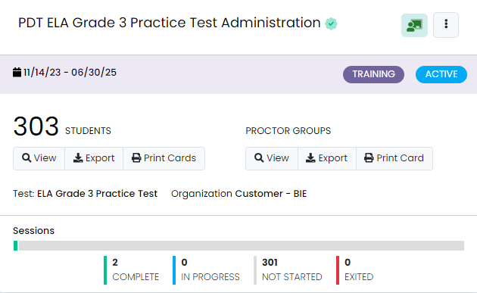
Manual Test Submission in ADAM
To determine if any student tests require manual submission, Test Coordinators can review the Sessions information located on the admin card for each individual test administration.
If any In Progress, Exited, or Resumed student statuses are listed under Sessions, these will need to be manually submitted in the proctor dashboard.

Slide 134
Submitted Tests – Progress Report
The number of tests submitted by test can be monitored using the Progress report.
Navigate to Reporting, then select Progress. Here you can view session progress for any selected test, including the number of tests in a Submitted, In Progress, and Not Started status.

Slide 135
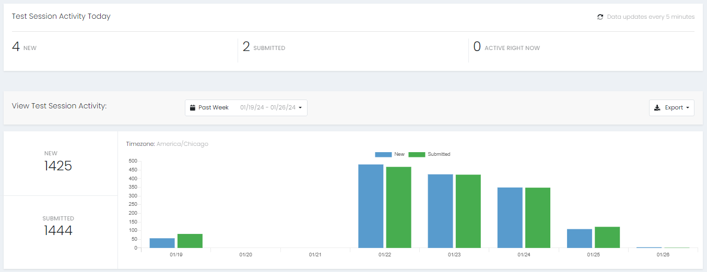
Submitted Tests – Activity Report
The number of tests submitted within a given window of time can be monitored using the Activity report.
Navigate to Reporting, then select Activity. Here you can view the number of test sessions that have been submitted within a selected window.

Slide 136
Rejected Tests – Paper-based Testing
If there is not a PreID label, the answer document will be scanned into ADAM.
ADAM will match First name, Last name, DOB, SSID (Student ID). System will attempt to auto-resolve any answer docs without a PreID label.
Any tests that are not auto-resolved will appear as a rejected test and must be resolved by May 9.

Slide 137
Rejected Tests in ADAM
In ADAM, under Operations, you’ll be able to select Rejected Tests and review any rejected tests for your school and resolve by assigning to the correct student record in ADAM.
More detailed instructions with screenshots will be posted to the BIE support site in late March 2024.

Slide 138
Reporting
138

Slide 139
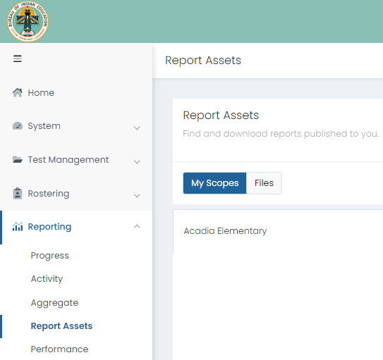
Summative Reports in ADAM
Once Summative reports (PDFs and CSV files) begin posting in ADAM, they can be accessed from Report Assets.
To access Summative reports:
Select Reporting
Select Report Assets
Locate and view reports either by selecting My Scopes or Files

Slide 140
Summative Assessment Reports Available – Preliminary
Preliminary Reports:
Individual Student Report (ISR) PDFs – growth & Spotlight QR code not available
Will be the same as final reports except they will have a preliminary watermark.

Slide 141
Summative Assessment Reports Available – Final
Final Reports:
Schools Standards Roster & companion file.
Student Reporting Category Roster.
Evidence Statement Analysis & companion file.
Reporting Category summary & companion file.
Demographic Performance Level summary & companion file.

Slide 142
Summative Assessment Reports Available – Final ISRs
Final ISR PDFs
Preliminary ISR will be replaced by final ISR PDFs, including growth data & Spotlight QR code.
Final ISR Printed Reports:
2 ISRs per student per subject.
1 Parent Report per student.

Slide 143
After Testing Checklist
143

Slide 144
After Testing Tasks – Computer-based Testing
Proctors
CBT – After Each Test on Day of Testing:
Collect Materials (student testing tickets, scratch paper, etc.).
Ensure students have logged out of TestNav correctly.
Return Materials to the Test Coordinator, as needed.
Notify Test Coordinator of absent students and/or students who need transcriptions.

Slide 145
After Testing Tasks – Computer-based Testing
Proctors and School Test Coordinators
CBT – Final Day of Testing:
Collect Materials (student testing tickets, scratch paper, etc.).
Ensure student test units have been submitted/completed.
Securely destroy materials that need to be destroyed.

Slide 146
After Testing Tasks – Paper-based Testing
Proctors
PBT – Day of Testing (After Each Test):
Collect materials (test booklets, answer documents, scratch paper, etc.).
Ensure names are on test materials.
Return materials to the Test Coordinator using chain of custody form.
Notify Test Coordinator of absent students and/or students who need transcriptions.

Slide 147
After Testing Tasks – Paper-based Testing
Test Coordinators
PBT - Final Day of Testing:
Collect materials (test booklets, scratch paper, etc.).
Ensure labels are affixed or data grids are completed
Return scorable materials to Pearson as soon as possible (no later than April 26, 2024)
Securely destroy materials listed in Test Coordinator Manual.
*If scorable materials are not picked up by April 26 there is no guarantee that records for these PBT students will be scored.

Slide 148
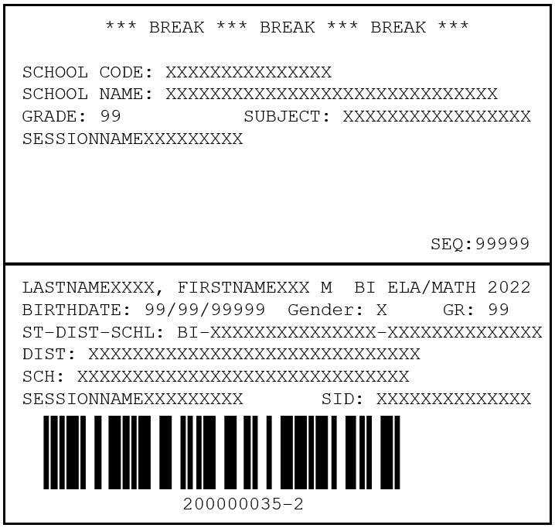
Student PreID Labels
Student PreID Labels will only be shipped for students assigned the Paper accommodation in ADAM by February 9, 2024.
This is extremely important for any student needing a paper accommodation.
Student PreID Label will go directly on the student’s test booklet (grade 3) or answer document (grades 4-HS). Using a label helps ensure we have the correct information for the student to complete scoring.
If a student PreID label is not used and Pearson is unable to match the student to a record in ADAM, an alert will be created. This will need to be resolved by the school.
If the school does not resolve the alerts/rejected tests by May 9, 2024, the student may not receive a report.
EXAMPLE

Slide 149
After Testing Tasks – Student PreID Labels
The student PreID label will override any bubbled demographic information.
Set aside student PreID labels that were not used to be securely destroyed/shredded.
If an PreID label is not available, grid all the fields on the data grid (must match info in ADAM).
Incomplete or incorrect bubbling will lead to rejected student tests that must be resolved.

Slide 150
After Testing Tasks – Reject Test Attempts
Rejected test alerts represent tests that will not be scored if not resolved by May 9.
If the information on the data grid does not match ADAM, it creates a rejected test alert for the school to resolve.
If student was placed into an online proctor group, but takes the paper-based version, a rejected test alert is created.

Slide 151
After Testing Tasks
One week after your school completes ELA/Math testing:
Resolve any rejected test alerts in ADAM.
Check ADAM daily after testing through May 9.
Organize and return nonscorable test materials.
Identify transcribed and damaged test materials as “Do Not Score”.
Complete a Post-Test Certification.
Destroy/shred scratch paper and used Mathematics Reference Sheets.
Keep records for three years.

Slide 152
After Testing Tasks – Paper-based Testing
Transcription Guidelines:
Complete Contaminated Document if needed.
At least two persons must be present during any transcription of student responses.
One person to transcribe.
One person to verify the transcription.
The Test Administrator shall transcribe the student responses.
The other must be a certified BIE educator to verify the transcription.
The student’s responses must be transcribed verbatim into the Answer Document.
Note for Braille transcription: Only a Braille certified proctor may transcribe student responses.
After transcription, shred any responses made from an assistive technology device.

Slide 153
After Testing Tasks – Separate Returns
Scorable and nonscorable are returned separately.
DO NOT mix these materials in boxes.
Different colored labels by program for scorable and non-scorable.
Program | Scorable | Nonscorable
ELA/Math | Red | Purple

Slide 154
After Testing Tasks – Return Shipping Labels
Ensure that you have return shipping labels.
These are shipped with the school coordinator kits.
These will not be overnighted, so make sure that you have these in time to return materials.
Scorable picked up by April 26, 2024*
Nonscorable picked up by May 9, 2024
*If scorable materials are not picked up by April 26 there is no guarantee that records for these PBT students will be scored.

Slide 155
After Testing Tasks – Prepare Materials for Shipping
Checklist to prepare materials for packing:
Scorable Test Booklets/Answer Documents have a Student PreID Label or hand-gridded student demographic and school data.
Scorable and nonscorable materials are packed separately for ELA/Math and are in the boxes in which they were delivered.
Boxes are not overfilled (under filled boxes are packed with crumpled paper).
One return shipping label (scorable or nonscorable) and one UPS label is placed on the top of each box.

Slide 156
After Testing Tasks
Secure Materials Must be Returned.
Every test booklet, answer document, and Math human reader script has a secure barcode and will be tracked.
Every secure test item must be returned, including Math human reader scripts.
Make sure that all materials are accounted for and returned.
If something must be destroyed locally (contaminated) then communicate with the BIE prior to destruction for further instructions.
Keep track of your UPS tracking numbers when shipping back materials.

Slide 157
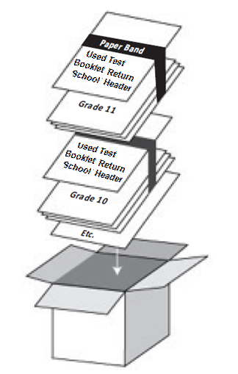
After Testing Tasks – Packaging Reminders
Packing Scorables:
Used test booklets (Gr 3).
Used answer documents (Gr 4-HS).
Transcribed into test booklets (Gr 3) or answer documents (Gr 4-HS).
Packing Scorable materials for Return Shipment:
Do not mix Scorable and Nonscorable materials in the same box.
One school, per box. Do not combine two schools’ test materials in one box.
Use appropriate shipping labels.
Once all materials are in boxes, indicate the sequence of boxes being returned for the school (e.g., Box 1 of 3, Box 2 of 3, and Box 3 of 3) on the return shipping label.
EXAMPLE

Slide 158
After Testing Tasks – Nonscorable Materials
Nonscorable materials:
Unused test booklets (including for absent students).
Unused answer documents (grades 4-high school).
Used test booklets (grade 3) and answer documents (grades 4-high school) that have been marked “Do Not Score”.
Used ELA/Math test booklets (grades 4-high school).
Large print test booklets (transcribed into scorable).
Braille test booklets (transcribed into scorable).

Slide 159
After Testing Tasks – Arrange for Pickup
Contact UPS at 800-823-7459 to schedule pickup:
Pickups must be scheduled at least 24 hours in advance.
UPS customer service is available 24/7 - tell UPS you are calling about a pickup request for Pearson and will be using their “Return Service”.
Once pickup is confirmed, you will get a confirmation number from UPS that can be referenced if questions or changes arise.
*If scorable materials are not picked up by April 26, 2024, there is no guarantee that records for these PBT students will be scored.

Slide 160
Resources
160

Slide 161
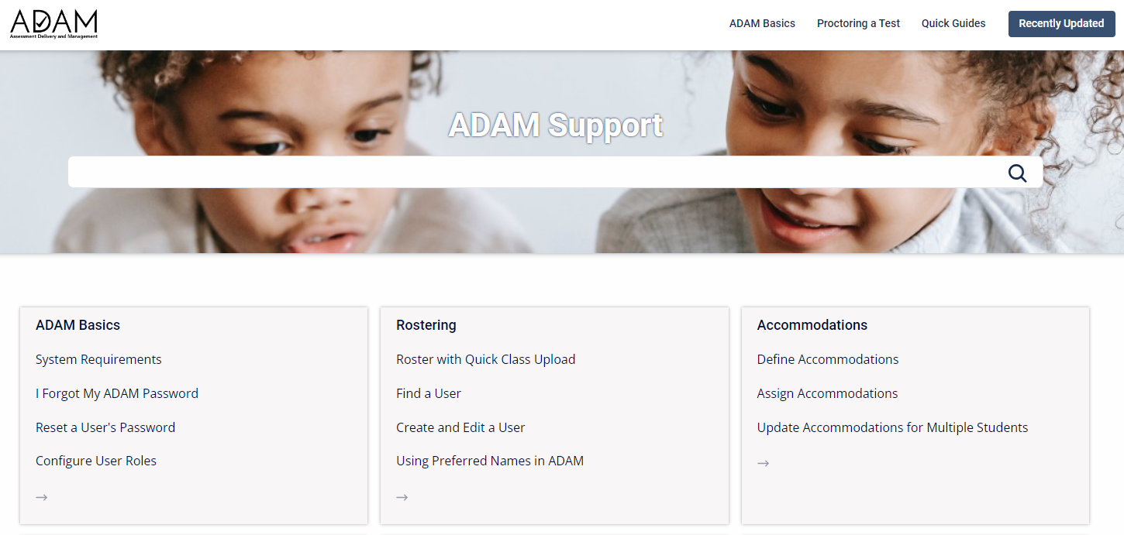
ADAM Support Site
Additional information from the ADAM support site can be accessed at https://support.assessment.pearson.com/as.
Step-by-step instructions and video’s on how to do basic functions in ADAM.

Slide 162
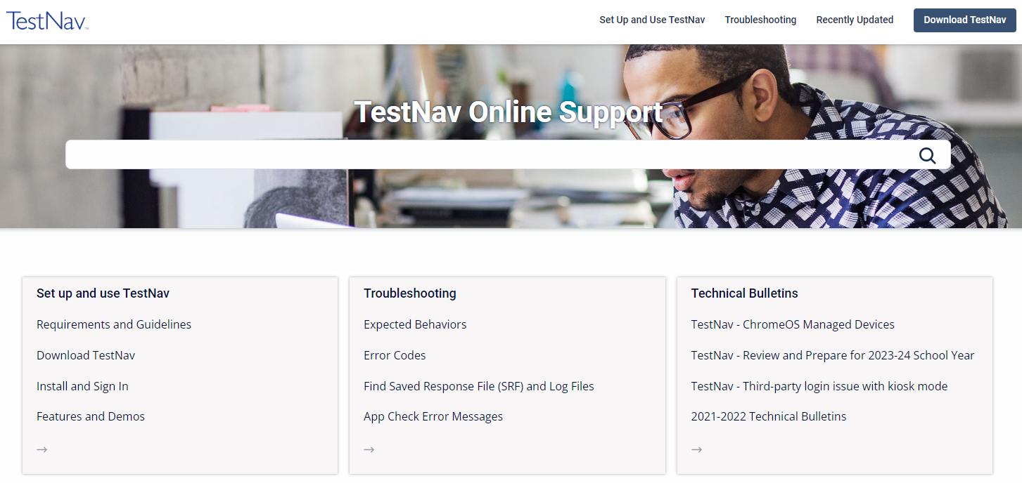
TestNav Resources
Additional information and links to the TestNav Resources can be accessed at the link below:
TestNav Online Support: https://support.assessment.pearson.com/display/TN/TestNav+8+Online+Support
TestNav System Requirements: https://support.assessment.pearson.com/display/TN/TestNav+System+Requirements

Slide 163
Support Site Resources
Practice tests, User documentation and guides are all available on the BIE customer portal at https://bie.mypearsonsupport.com.
BIE Support Site
Technology requirements
Training manuals
Testing documentation
Practice tests

Slide 164
Support Site Resources
All Test Administration Manuals, Test Coordinator Manual, test scripts, and other tools and forms available on the Summative Resources tab.

Slide 165
Support Site Resources
Practice tests and additional resources found under Practice Tests tab.

Slide 166
Infrastructure Trial
Infrastructure Trial is dress rehearsal for the operational administration conducting in the Practice training administration in ADAM. This is optional and at the discretion of the schools.
Available January 29 - February 23, 2024
Provides an opportunity for schools to:
Check network bandwidth.
Ensure TestNav is configured correctly on devices.
Ensure participating staff know what to do during computer-based testing, including creating proctor groups and adding students.
Students are familiar with the CBT tools and format.

Slide 167
Infrastructure Trial
Find more information and the Infrastructure Trial Guide on the BIE support page.

Slide 168
Next Steps and Looking Ahead
168

Slide 169
Next Steps
Train all staff involved with Summative testing (today’s presentation and related resources).
Read the Test Coordinator Manual, Test Administration Manual, and Accessibility Features and Accommodations Manual (each manual has checklists for testing).
Verify and update student accommodations in ADAM by February 9, 2024.
Prepare student testing devices.

Slide 170
Forms for Administration
Prior to testing
Security Agreement
During Testing
Irregularity Report
Contaminated, Damaged, or Missing Materials
School Chain of Custody (maintained locally)
After Testing
Post Test Certification Form
All forms can be found at https://bie.mypearsonsupport.com/.

Slide 171
Item Development for Summative Assessments
The BIE and Pearson are current working on the development of new ELA and Math items for Summative assessments.
Spring 2024 will be the first administration with BIE culturally relevant test items.
These items are designed to be culturally relevant and sensitive to the Native American student population.
There are several opportunities for BIE educators to participate in this development process. https://bie.mypearsonsupport.com/

Slide 172
BIE Upcoming Trainings
172

Slide 173
Reports Training
School Reports
Individual Student Reports (ISR)
Reporting Category Roster
School Standards Roster
Reporting Category Summary
Evidence Statement Analysis
Demographic Performance Level Summary
Fall
2024

Slide 174
Support and Contacts
174

Slide 175
Pearson Customer Support
BIE Customer Support
1-833-302-9587 Monday – Friday
3:30 am – 4:30 pm (PT)
4:30 am – 5:30 pm (MT)
5:30 am – 6:30 pm (CT)
6:30 am – 7:30 pm (ET)

Slide 176
BIE Contacts
For General Questions related to the ELA and Math Assessment:
Aurelia Shorty, Education Specialist, aurelia.shorty@bie.edu
For questions related to Assessment data files:
Dr. Rebecca Izzo, Research Analyst, rebecca.Izzo@bie.edu

Slide 177
Questions?
177

Slide 178
End of Presentation
178
Notes:
Closing Slide

